Slide 1
I210 Information Infrastructure
Lab 11

Slide 2
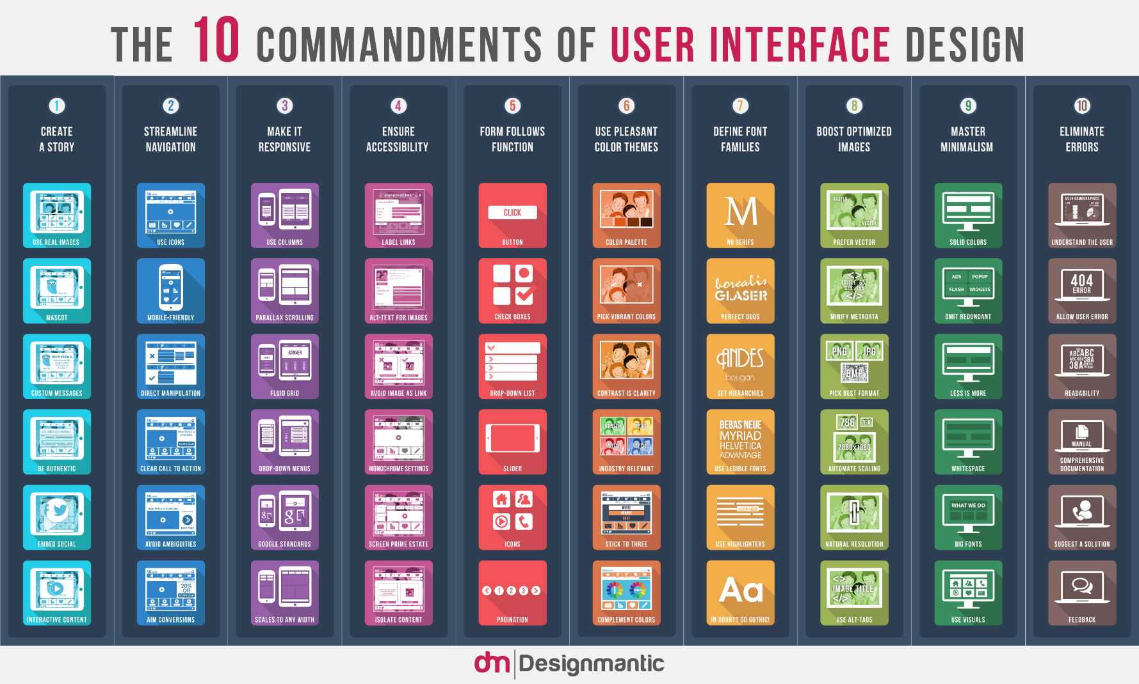
Topic
Today’s focus is GUIs.

Slide 3
Quick Review – GUI Starter Template
from tkinter import *
class Application(Frame):
def __init__(self, master):
Frame.__init__(self, master)
self.grid()
self.create_widgets()
def create_widgets(self):
self.lbl = Label(self, text="This is a label!")
self.lbl.grid()
self.bttn1 = Button(self, text = "I do nothing!")
self.bttn1.grid()
# main
root = Tk()
root.title("Basic Application Class GUI")
root.geometry("400x200")
root.resizable(width = FALSE, height = FALSE)
app = Application(root)
root.mainloop()
Don’t start GUIs from a blank file!
Use a basic template, like this one, to help you get started!
On Oncourse as gui_starter.py

Slide 4


Quick Review – Syntax for Buttons
from tkinter import *
class Application(Frame):
def __init__(self, master):
Frame.__init__(self, master)
self.grid()
self.create_widgets()
def create_widgets(self):
self.bttn = Button(self, text = "BEFORE", command = self.update_button)
self.bttn.grid()
def update_button(self):
self.bttn["text"] = "AFTER"
# main
root = Tk()
root.title("Event Handler Demo")
root.geometry("250x25")
root.resizable(width = FALSE, height = FALSE)
app = Application(root)
root.mainloop()

Slide 5
Quick Review – Text Entry
A text entry field (width is not required):
self.ent = Entry(self, width=30)
Getting the text currently in the text entry:
self.ent.get()
Removing all text currently in the text entry:
self.ent.delete(0, END)
Inserting new text into the text entry:
self.ent.insert(0, "This is a new value.")

Slide 6
Quick Review – Interacting with Text Boxes
self.txt = Text(self, width = 35, height = 5, wrap = WORD)
Getting the text currently in the text box:
self.txt.get(0.0, END) #text boxes are 2-d !
Removing all text currently in the text box:
self.txt.delete(0.0, END)
Inserting new text into the text box:
self.txt.insert(0.0, "test")

Slide 7
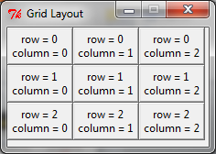
Quick Review – GUI Gridding
Tkinter uses a grid layout with rows and columns:
A 3x3 example:
self.label.grid(row = 0, column = 0, columnspan = 2, sticky = W)
row and column determine where the element is located
columnspan (or rowspan) allow an element to exist in multiple columns or rows
sticky justifies the element to one of:
N – Top
W – Left E – Right
S – Bottom
If you don’t enter a value for sticky, the widget will be centered!

Slide 8
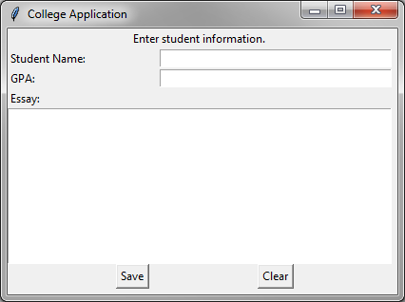
Quick Review – Gridding
from tkinter import *
class Application(Frame):
def __init__(self, master):
Frame.__init__(self, master)
self.grid()
self.create_widget()
def create_widget(self):
Label(self, text="Enter student information.").grid(row=0, column=0, columnspan=3, sticky=S)
Label(self, text="Student Name:").grid(row=1, column=0, sticky=W)
Label(self, text="GPA:").grid(row=2, column=0, sticky=W)
Label(self, text="Essay:").grid(row=3, column=0, sticky=W)
self.student_name = Entry(self, width=40)
self.student_name.grid(row=1, column=1, columnspan=2, sticky=W)
self.student_gpa = Entry(self, width=40)
self.student_gpa.grid(row=2, column=1, columnspan=2, sticky=W)
self.essay = Text(self, width = 50, height = 10, wrap = WORD)
self.essay.grid(row = 4, column = 0, columnspan = 3, sticky = W)
Button(self, text = "Save").grid(row = 5, column = 0, columnspan = 2, sticky = S)
Button(self, text = "Clear").grid(row = 5, column = 2, sticky = W)
# main
root = Tk()
root.title("College Application")
root.geometry("410x280")
app = Application(root)
root.mainloop()
Column 0
Column 1
Column 2
Row 0
Row 1
Row 2
Row 3
Row 4
Row 5

Slide 9
How to Design a GUI
What will the GUI accomplish?
What inputs does the user need?
How should they be arranged?
What will the user’s flow be through the interface?

Slide 10
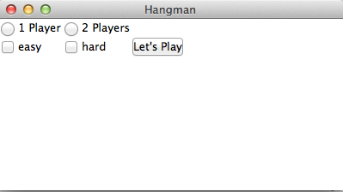
Hangman Game, Pt. 1 (Group Work)
Replicate this interface for starting a game of hangman:

Slide 11
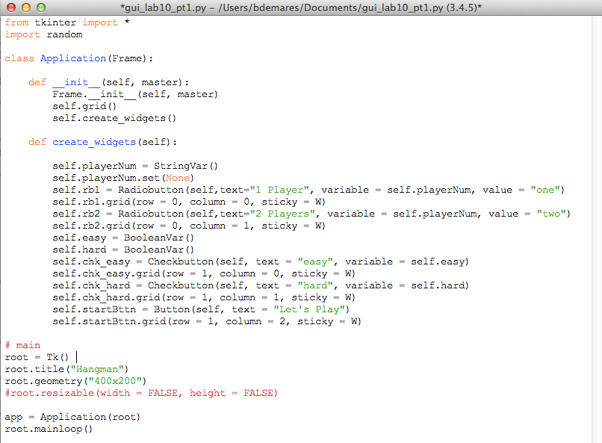
Graphic Design (Example Solution)

Slide 12
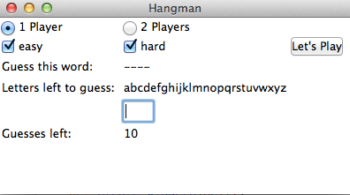
Hangman Game, Pt. 2 (Group Work)
Let’s add some functionality – based on the checkboxes the user chooses, randomly select a word from hard_words.txt, easy_words.txt, or both (see Canvas for files).
After the “Let’s Play” button is pressed, new elements should appear in the frame, as shown here.
Hint: a dash appears for every letter of the random word.

Slide 13
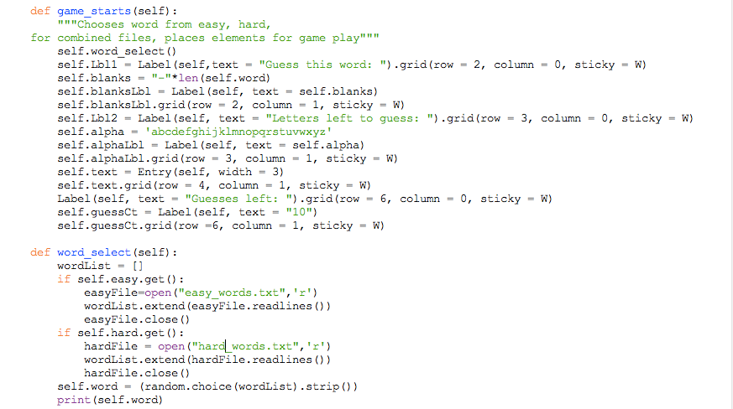
Hangman Game (Pt. 2 Solution)
Also add command = self.game_starts
to self.startBttn in create_widgets()

Slide 14
Quick Review – Keys and Events
If I create a widget:
self.text = Text(root, width = 50, height = 12)
self.text.grid()
I can bind an event to it for a generic key press like this: self.text.bind('<KeyPress>', self.record)
This tells Python to run the self.record() method when this event occurs!

Slide 15
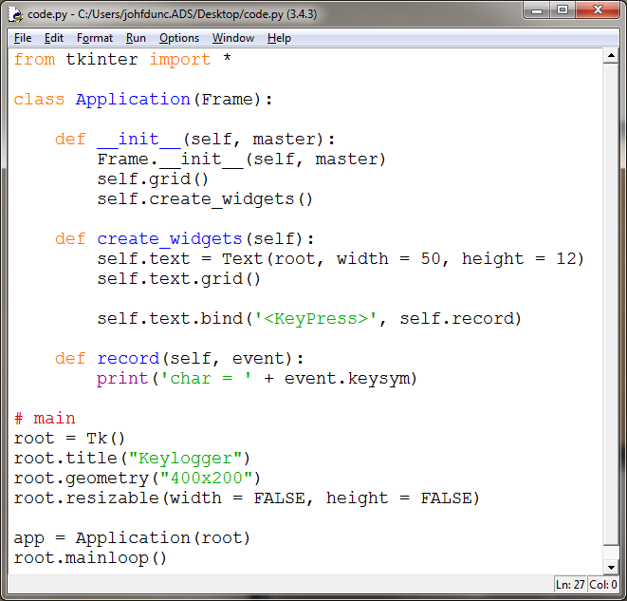
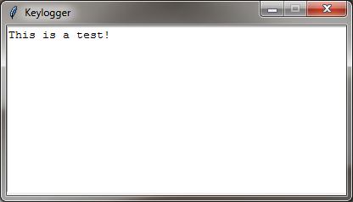
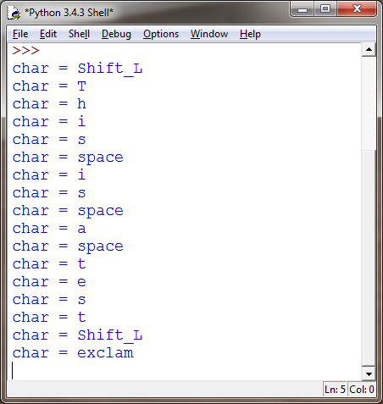
Quick Review – Keylogger
This program copies all keystrokes to the shell:

Slide 16
Quick Review – Click Counter 3
The first new section of code sets up the event handler and sets the focus.
The second one simulates a button press if the key is the SPACE bar.
def create_widgets(self):
self.lbl = Label(self, text="Click to increment!")
self.lbl.grid()
self.bttn = Button(self, text = "Total Clicks: 0", command = self.update_count)
self.bttn.grid()
self.bttn.bind('<KeyPress>', self.space_click)
self.bttn.focus_set()
def update_count(self):
self.bttn_clicks += 1
self.bttn["text"] = "Total Clicks: " + str(self.bttn_clicks)
def space_click(self, event):
if event.keysym == "space":
self.update_count()

Slide 17
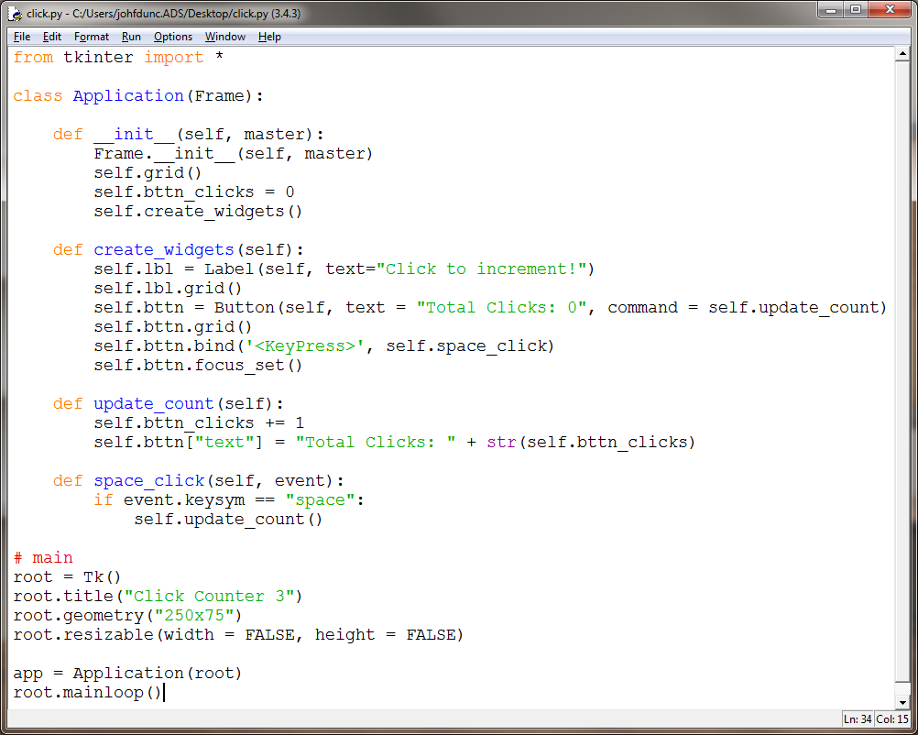
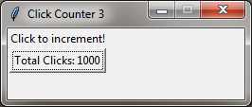
Quick Review – Click Counter 3
Hold down the SPACE bar and watch those ‘clicks’ fly by!

Slide 18
Hangman Game, Pt. 3 (Group Work)
More functionality:
When the user types a letter, remove the letter from the alphabet list.
If the letter is in the random word, replace the dash(es) with the letter in the GUI.
If the letter is not in the word, reduce number of guesses left by 1.

Slide 19
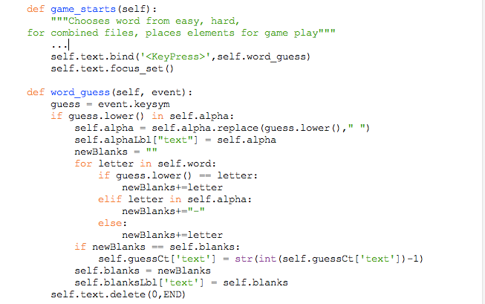
Hangman Pt. 3 (Partial Solution)

Slide 20
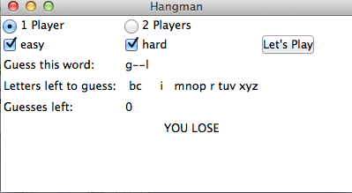
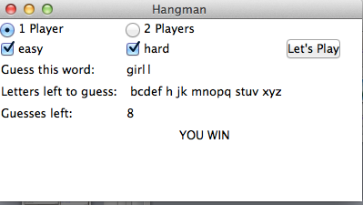
Hangman Game, Pt. 4 (Group Work)
Ending the game:
If all the guesses are used up, display a message that says “YOU LOSE”
If the player guesses all the letters before running out of guesses, display “YOU WIN”.
If the user clicks “Let’s Play” again, a new word is selected, end messages are erased (use .grid_remove() for each element you want to erase), and number of guesses reverts to 10.

Slide 21
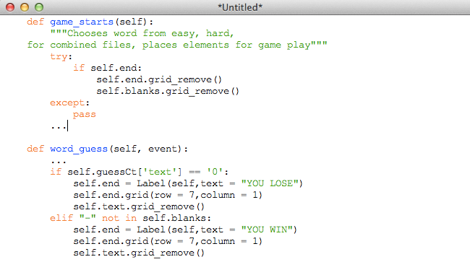
Hangman Pt. 4 (Example Solution)

Slide 22
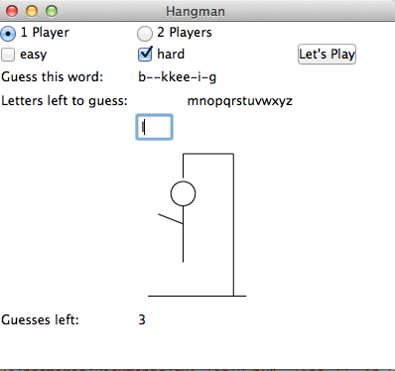
Hangman Game, BONUS, 2 pts (Group Work)
Between the Entry field and the guess count, include an image of the hangman, with Hangman-0.gif first, then Hangman-1.gif after one wrong guess, up to Hangman-10.gif (see Canvas for files).
You can add images to Labels as you would text:
self.lbl1=Label(self,image=“picture.gif”)

Slide 23
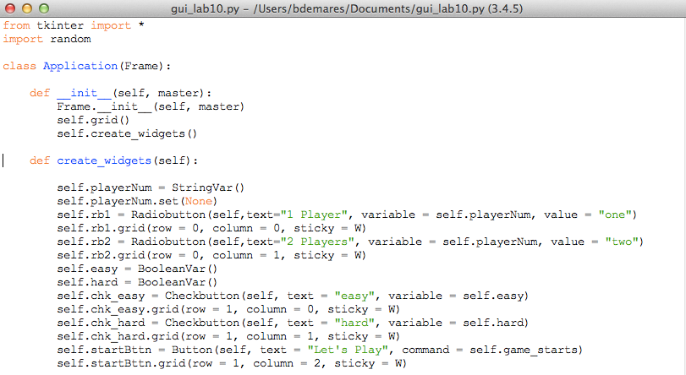
Hangman (Full Solution)

Slide 24
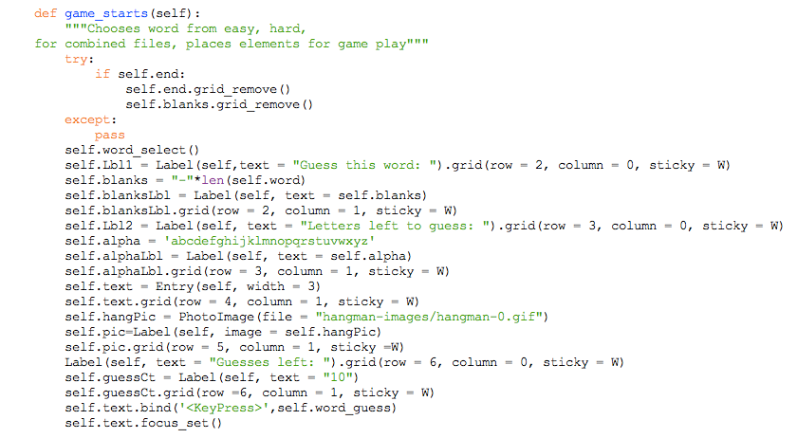
Hangman (Full Solution, cont’d)

Slide 25
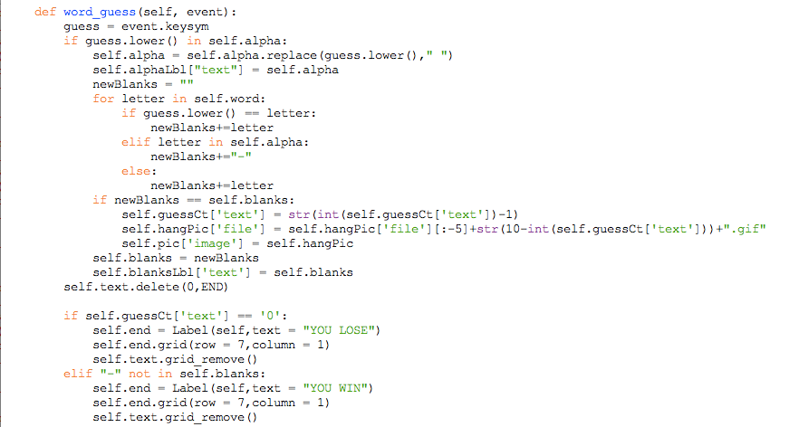
Hangman (Full Solution, cont’d, 3)

Slide 26
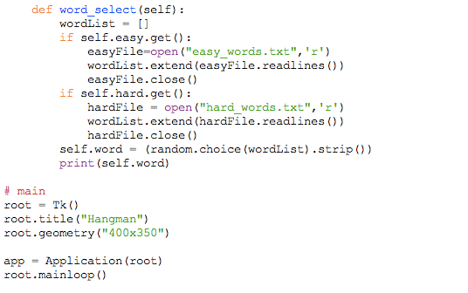
Hangman (Full Solution, cont’d, 4)

Slide 27
Questions?

